Slide 1
Module 1 – introduction to 8086

Slide 2
Addressing Modes of 8086
Category of instructions
Sequential Control Flow instructions
Control Transfer Instructions

Slide 3
Types of instructions
Sequential Control Flow instructions – after execution of one instruction, it transfers control to the next instruction appearing immediately after it. Ex., Arithmetic, logical, data transfer etc.
Control Transfer Instructions – Transfers control to a pre-defined address or to an address specified in the instruction after an execution. Ex., INT, CALL, RET, JUMP

Slide 4
Addressing modes – Sequential Control Flow Instructions
Immediate – immediate data is a part of instruction. Ex., MOV AX, 0006H
Direct – 16 bit memory or I/O address is directly specified in the instruction. Ex., MOV AX, [2000H]
Register – Data is first stored in register and then referred from that register. Ex., MOV BX, AX
Register Indirect – Uses offset registers to determine the address of the memory location that contains data. Ex., MOV AX, [BX]. Usually, offset address is in BX, SI or DI

Slide 5
Continued…
Indexed – offset of the operand is stored in one of the indexed registers. DS and ES are the default segments for SI and DI respectively. Ex., MOV AX, [DI]
Register Relative – Data is available at an effective address formed by adding an 8 bit or 16 bit displacement with the content of any of the registers BX, BP, SI and DI in the default segment. Ex., MOV AX, 50H[BX]
Based Indexed – Adding content of the base register (any one of BX or BP) with the content of an index register (any one of SI or DI). The default segment register may be ES or DS. Ex., MOV AX, [BX] [SI]

Slide 6
Continued…
Relative Based Indexed – By adding an 8 or 16 bit displacement with the sum of contents of any one of the base registers BX or BP and any one of the indexed registers in a default segment. Ex., MOV AX, 50H [BX] [SI]

Slide 7
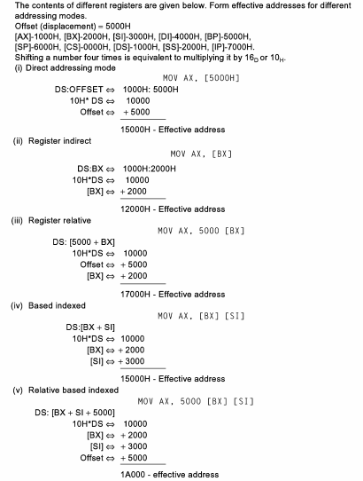

Slide 8
Addressing modes – Control transfer Instructions
Addressing mode depends upon
whether the destination location is within the same segment or in a different one.
method of passing the destination address to the processor

Slide 9
Types of addressing modes for control transfer instructions
Modes for control transfer instructions
Intersegment
Intra-segment
Intersegment direct
Intersegment indirect
Intra-segment direct
Intra-segment indirect

Slide 10
Intra-segment Direct Mode
Address to which the control is to be transferred lies in the same segment in which the control transfer instruction lies and appears directly in the instruction as an intermediate displacement value.
Ex., JMP SHORT LABEL ( LABEL lies within -128 to +127 from the current IP content.

Slide 11
Intra-segment indirect mode
Address to which the control is to be transferred lies in the same segment in which the control transfer instruction lies but is indirectly passed to the instruction.
Ex. JMP [BX] – Jump to effective address stored in BX

Slide 12
Intersegment direct
The address to which the control is to be transferred is in a different segment.
Provides a means of branching from one code segment to the other
The CS and IP of the destination address is specified directly in the instruction
Ex., JMP 5000H : 2000H

Slide 13
Intersegment indirect
The address to which the control is to be transferred is present in another segment and is passed to the instruction indirectly.
The memory block pointed is one among these: IP (LSB), IP (MSB), CS (LSB), CS (MSB)
Ex., JMP 2000H

Slide 14
Example
Assume that the subroutine is in a different code segment, where CS = 3000H. What is the effective address of the instruction CALL 3000H:0030H?

Slide 15
Weblinks
https://www.youtube.com/watch?v=p9wxyIx-j-c

